Slide 1
MAI AGENTIC AI MASTERCLASS · WEEK 5
Crisis Coach
Architecture
A voice-first agent for the first ten minutes after a collision. Seven views of how it is built.
Draft v1.0 · 8 September 2026

Slide 2
What is in this deck
A technology stack is one view. An architecture needs several.
VIEW
THE QUESTION IT ANSWERS
SLIDE
Context & boundary
What is inside the system, who is outside it, and which of them we actually talk to
3
Technology stack
What we build on, layer by layer — and what is bought versus custom built
4
The agent graph
The control flow. Which node runs when, and what can pre-empt what
5
One turn, end to end
How a single utterance crosses the stack, and where the 2.5 seconds go
6
Data architecture
What data exists, where each kind lives, and how long it stays
7
Autonomy & safety
What the agent does alone, what it must ask, and where it stops
8
Deployment & NFRs
What runs where, and the targets the design has to hit
9 – 10
Layer detail
Each layer: what it carries, how it connects, and the decision that matters
11 – 17
Decisions & next steps
What we chose, what we rejected, and what happens after this
18 – 19

Slide 3
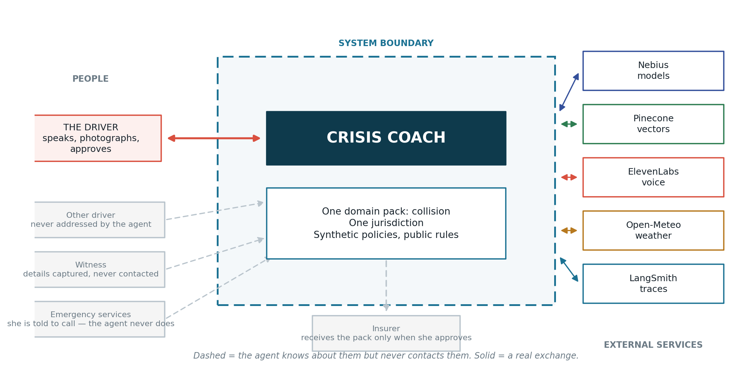
Context & boundary
What is inside the system, and who is outside it.
The agent never contacts anyone. It tells her to call the emergency services; it sends the pack to her insurer only when she approves.

Slide 4










CRISIS COACH · AGENTIC AI TECH STACK
OFF THE SHELF
CUSTOM BUILT
logo = bought in
CUSTOM
the domain judgement
Only the layers we use. Every block: the tool, and what it is for.
1 · APPLICATION
6 · OBSERVABILITY / EVALS
7 · AI SAFETY / GUARDRAILS
Streamlit
ElevenLabs
Photo capture
CUSTOM BUILT
python-docx
CUSTOM BUILT
Phone-shaped web UI
Voice in and out
Live shots or upload
The evidence pack
LangSmith
Hard stops
Trace per scene,
span per turn
Injury, hostility, fire —
the run ends
2 · AGENTIC FRAMEWORK
CUSTOM BUILT
CUSTOM BUILT
CUSTOM BUILT
LangGraph
LangChain
Hard-stop
Scene planner
Prohibited speech
Scene loop, interrupts
Model + tool binding
Runs before every turn
Value ÷ time left
Never coaches an
admission of fault
Experiments
3 · TOOLS / APIs
Prompt changes scored
on the goldens
CUSTOM BUILT
Capture
CUSTOM BUILT
Party
CUSTOM BUILT
Knowledge
CUSTOM BUILT
Output
CUSTOM BUILT
Open-Meteo
Approval gates
Photo, statement, GPS
Licence + insurer
Policy and duties
Pack, file — gated
Weather by time
Nothing leaves the
phone on its own
CUSTOM BUILT
Golden datasets
CUSTOM BUILT
4 · KNOWLEDGE, DATA & MEMORY
Six scripted scenarios,
known answers
Grounding
Pinecone
SQLite
Domain pack
CUSTOM BUILT
Profile memory
CUSTOM BUILT
Every claim cites
its source
Four corpora, warmed
Ledger + scene clock
Collision rules and items
Car, policy, past incidents
CUSTOM BUILT
CUSTOM BUILT
5 · MODEL PROVIDER & CLOUD INFERENCE
Scenario runner
Zero-tolerance
Deterministic replay,
no provider needed
Two eval metrics that
fail the build
Nebius · fast
Nebius · reason
Nebius · embed
Nebius · vision
Classify and word
Answer and assemble
Indexing for Pinecone
Is the plate legible?
EVERY ONE CUSTOM BUILT
No vendor sells these rules.
LOCATION & WEATHER: device GPS, or pick a city for the demo — place names from OpenStreetMap · Open-Meteo returns the conditions at that exact timestamp, free and keyless

Slide 5
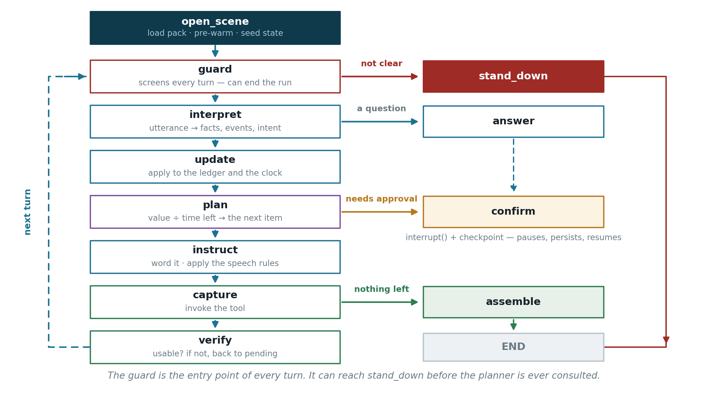
The agent graph
LangGraph. Twelve nodes, and one that pre-empts the rest.
The graph is the supervisor — no model chooses the next node. Routing is a conditional edge on typed state, which is why the ordering can be scored.

Slide 6
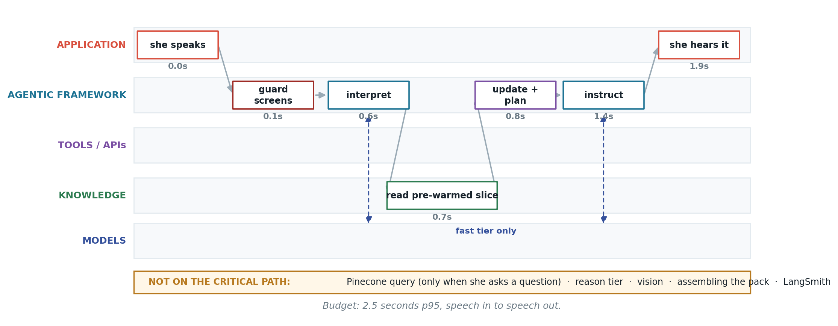
One turn, end to end
Where the 2.5 seconds go — and what is deliberately off the critical path.
Retrieval happens before the crisis starts, not during it. Only the fast tier runs on a turn; the reason tier, vision and the pack are all off-path.

Slide 7
Data architecture
What exists, where it lives, and how long it stays.
DATA
WHERE IT LIVES
WHY THERE
LIFETIME
The four corpora
Pinecone — policy, duties, intake, denials namespaces
Semantic lookup over prose. Every chunk carries its provenance.
Static; rebuilt when the pack changes
Evidence ledger & scene clock
SQLite, on the device
Counts, statuses and windows are arithmetic. Never approximated.
One scene; kept with the incident
Her profile
SQLite, on the device
Car, policy, contacts, past incidents. Read at scene open.
Persistent, hers
The domain pack
Files, versioned with the code
Evidence catalogue, scene events, hard-stop and speech rules.
Read-only at runtime
Photographs & statement
Device storage until she sends
Nothing leaves the phone without an explicit approval.
Until she deletes it
Traces & eval runs
LangSmith
One trace per scene. Synthetic scenarios only — never a real incident.
Retained for comparison
No real personal data anywhere in the prototype. Two synthetic profiles, fabricated policies, public rules.

Slide 8
Autonomy & safety model
What it does alone, what it must ask, and where it stops.
TIER
WHAT SITS HERE
ENFORCED BY
PROVEN BY
ACTS ALONE
Ordering the collection · re-requesting a failed capture · logging time, place and weather · drafting her statement · answering from the corpus
Default. No gate.
Ordering fidelity 5/5 on the interrupt scenarios
CONFIRMS FIRST
Anything said to the other party · contacting a third party · anything sent to the insurer
requires_approval on the tool → confirm node → interrupt()
Commitment log matches the transcript, 100%
STANDS DOWN
Injury to anyone · hostility · fire or fuel · a weapon · signs of a staged collision
The guard node, which runs before the planner on every turn
Escalation correctness 100% — a build gate
NEVER
An opinion on fault · legal or insurance advice · calling emergency services itself · coaching an admission
Prohibited-speech rules in the pack, applied at instruct
Zero prohibited coaching — a build gate
Safety is structural, never predicted. The guard is a node, approval is a field, grounding is a retrieval contract.

Slide 9
Deployment view
What runs where — and what happens when the network does not.
COMPONENT
RUNS WHERE
NETWORK NEEDED?
IF IT IS UNREACHABLE
Streamlit app, graph, ledger, clock, planner, tools
On the device / local process
No
Nothing to lose — this is the part that must keep working
Domain pack and the pre-warmed slice
Loaded into memory at scene open
No, once loaded
The scene continues on what was already fetched
Nebius — fast tier, reason tier, embeddings, vision
Cloud
Yes
At open: refuse to start. Mid-scene: fall back to pack templates
Pinecone
Cloud
At scene open only
Serve the pre-warmed slice; refuse ad-hoc questions
ElevenLabs
Cloud
Yes, for voice
Fall back to the text console on the same turn contract
Open-Meteo · OpenStreetMap
Cloud
One call each
Record conditions as unknown rather than guess
LangSmith
Cloud
No — never on the critical path
Buffer locally; evals still run offline

Slide 10
Non-functional requirements
The targets the design has to hit, and what in the architecture delivers each.
REQUIREMENT
TARGET
WHAT DELIVERS IT
Turn latency
Under 2.5 seconds, p95, speech in to speech out
Pre-warmed retrieval, a fast model tier on the turn, and a deterministic planner that costs nothing
Safety response
Stand down within one turn of any injury signal, 100%
The guard is the entry node of every turn and can terminate before the planner runs
Correctness of the record
90%+ of the insurer's required fields; every claim cited
The intake spec drives completeness; provenance travels with every chunk
Privacy
Nothing leaves the device without an explicit approval
One tool writes outward, and it is gated by the confirm node
Reproducibility
The same scenario gives the same ordering every run
A scripted clock and scripted context, so evals measure the agent and not the weather
Cost per scene
Small enough that the eval suite can run on every change
Two tiers: the small model on the turn, the larger one only off the critical path

Slide 11
LAYER 1 · APPLICATION
Everything she touches. It decides nothing.
1
2
3
4
5
6
7
WHAT THIS LAYER CARRIES
HOW IT CONNECTS
Streamlit
ElevenLabs
Sends a TURN to the agent core
The phone-shaped surface. One instruction at a time, plus what is still outstanding.
Speech in and out, with barge-in so she can cut it off mid-sentence.
↓
Text, an optional photograph, a timestamp. No intent, no classification, no opinion.
Receives an INSTRUCTION back
Photo capture
python-docx
↑
One line to say, and what it expects next: a photograph, an answer, or a confirmation.
Guided live shots against the requested item, or upload of pictures she already took.
Renders the evidence pack — photographs, details, statement, times, places.
Talks to nothing else
—
No retrieval, no model calls, no branching. Every decision belongs to layer 2.
Session control
Location
Start in one action. Stop at any moment. Resume later with everything intact.
Device GPS when available, or a city picked by hand for the prototype.
THE DECISION THAT MATTERS HERE
Text is the reference implementation; voice is an adapter over the same turn contract.
That is the only reason voice cannot take the build down — if ElevenLabs is unavailable, the identical scene runs typed and every eval still passes.
FEATURES IT DELIVERS
3
4
6
7
19
20
28
29
30
IF IT FAILS
Voice falls back to the text console on the same contract. The camera falls back to upload. She loses the feel of it, not the outcome.

Slide 12
LAYER 2 · AGENTIC FRAMEWORK
LangGraph. The part that decides.
1
2
3
4
5
6
7
WHAT THIS LAYER CARRIES
HOW IT CONNECTS
The graph
Hard-stop guard
Returns instructions to layer 1
Twelve nodes. Guard, interpret, update, plan, instruct, capture, verify — plus four exits.
Entry point of every turn. Can end the run before the planner is ever reached.
↑
One at a time, already worded, with what it expects back.
Calls tools, knowledge and models
Scene clock
Priority planner
↓
Tools for actions, the pre-warmed slice for facts, the fast tier for classification and wording.
Tracks events, not seconds. Each event holds a window that interpretation revises.
Selects by value ÷ time left, and emits the whole comparison it made.
Emits to observability, obeys safety
→
One span per turn carrying the guard verdict, the clock, and the planner's comparison.
Evidence ledger
Interrupts
Every item with live status: pending, captured, failed, unreachable — and why.
interrupt() plus a SQLite checkpointer, so a scene pauses for approval and resumes.
THE DECISION THAT MATTERS HERE
The graph is the supervisor. No model chooses the next node.
Routing is a conditional edge on typed state — which is why the ordering can be scored against a golden sequence, and why the hard stop cannot be routed around.
FEATURES IT DELIVERS
5
6
7
8
9
10
11
16
17
18
27
IF IT FAILS
If the model tier is unreachable mid-scene, instructions fall back to the pack's untemplated text. The phrasing gets blunter; ordering and safety are unaffected.

Slide 13
LAYER 3 · TOOLS / APIs
Nine typed actions. The autonomy ladder lives here.
1
2
3
4
5
6
7
WHAT THIS LAYER CARRIES
HOW IT CONNECTS
Capture tools
Extract party
Called only by the agent core
capture_photo · capture_context · record_statement. Time, place and conditions logged unasked.
Licence and insurance card into structured fields, from a photograph or from speech.
↑
Never by the interface, never by another tool. One caller keeps the audit trail honest.
Reaches the device and the world
Knowledge tools
Output tools
↓
Camera and GPS through layer 1, policy and duties through layer 4, weather through Open-Meteo.
check_policy and assess_duties. Retrieval with a citation on every answer.
build_evidence_pack assembles locally. file_fnol is the only tool that leaves the device.
The registry IS the safety gate
→
requires_approval is data on the tool, so the confirm node cannot be bypassed by a prompt.
Open-Meteo
The registry
Free and keyless. Conditions at that exact timestamp, not today's forecast.
Each tool declares an argument schema, a mode, and whether it needs approval.
THE DECISION THAT MATTERS HERE
Approval is a property of the tool, declared once.
Only file_fnol leaves the phone, so only file_fnol is gated. Keeping that line sharp is what stops the confirmation becoming noise she learns to tap through.
FEATURES IT DELIVERS
11
12
13
14
15
20
21
24
IF IT FAILS
A capture that fails verification twice is marked FAILED with a reason and the planner routes around it. Open-Meteo down means conditions are recorded as unknown, never guessed.

Slide 14
LAYER 4 · KNOWLEDGE, DATA & MEMORY
One job per store.
1
2
3
4
5
6
7
WHAT THIS LAYER CARRIES
HOW IT CONNECTS
Pinecone · policy
Pinecone · duties
Pre-warmed at scene open
Her excess, protected no-claims, and the 24-hour notification clause nobody reads.
When police must attend, the duty to exchange details, private-land rules, reporting windows.
↑
Policy and duties are fetched once, before the crisis work starts. There is no time to search mid-instruction.
Embeddings come from Nebius
Pinecone · intake
Pinecone · denials
↓
The same provider indexes the corpora and embeds the query, so both sides of retrieval match.
The fields and photographs the claim form actually demands. This drives completeness.
Why claims genuinely fail — admitted liability, cars moved, no witness details.
Every chunk carries provenance
→
Namespace, document, section, text. An assertion without a citation is a defect, scored at 100%.
SQLite
Domain pack
Evidence ledger, scene clock, her profile and past incidents. Exact and queryable.
Evidence catalogue, scene events, hard-stop and speech rules. Read-only at runtime.
THE DECISION THAT MATTERS HERE
Pinecone holds knowledge. SQLite holds numbers and structure. The pack holds the domain.
A completeness count is arithmetic, and arithmetic does not belong in a component that returns nearest neighbours.
FEATURES IT DELIVERS
1
2
9
16
17
21
23
25
26
29
30
IF IT FAILS
If Pinecone is unreachable the agent serves the pre-warmed slice already in state and refuses ad-hoc questions rather than improvising. It degrades toward silence, never toward invention.

Slide 15
LAYER 5 · MODEL PROVIDER & CLOUD INFERENCE
Nebius. Two tiers, chosen per node.
1
2
3
4
5
6
7
WHAT THIS LAYER CARRIES
HOW IT CONNECTS
Fast tier
Reason tier
Called by the agent core and vision tools
Runs on every turn: the guard's classifier, interpretation, and wording. Inside the 2.5s budget.
Off the critical path: answering a question, assessing duties, assembling the pack.
↑
Nothing else reaches the provider. One place to change the model, one place to measure it.
OpenAI-compatible wire format
Embeddings
Vision
↓
Nebius speaks it, so the provider is a base URL and a model name in config rather than an architectural commitment.
Corpus ingestion and query embedding for Pinecone. One provider for both sides.
inspect_photo and extract_party. Is that number plate actually legible?
Every call is a span
→
Which tier, which node, how long, how much. That is what makes the tier split defensible rather than a guess.
Structured output
Accounting
Pydantic schemas on every call, one retry on a malformed reply, then fail honestly.
Tokens, latency and cost per tier and per node, fed to the observability layer.
THE DECISION THAT MATTERS HERE
Two tiers, selected per node — not one model for everything.
The model that words an instruction to someone standing in the rain and the model that writes the closing narrative have different jobs. One is judged on latency, the other on quality.
FEATURES IT DELIVERS
12
13
22
23
IF IT FAILS
Unreachable at scene open: refuse to start with a clear message rather than half-guiding someone through a collision. Unreachable mid-scene: fall back to pack templates.

Slide 16
6 · OBSERVABILITY / EVALS
LangSmith. How we know it works — and catch it when it does not.
1
2
3
4
5
6
7
WHAT THIS LAYER CARRIES
HOW IT CONNECTS
Traces
Planner comparison
Instrumented from the agent core
One trace per scene, one span per turn. The record of what the agent believed and chose.
Every span carries the urgency table it weighed — not only the item it picked.
↑
The graph emits; nothing else has to remember to log. Coverage is structural rather than diligent.
Reads nothing, changes nothing
Golden datasets
Experiments
↓
Purely observational at runtime. It cannot alter a scene, which is why it is safe to leave switched on.
Six scripted scenarios: clean run, two interrupts, injury, hostility, apology.
Every prompt or pack change runs against the goldens and is compared with the last version.
Two metrics are build gates
→
Escalation correctness and prohibited coaching have no tolerance. They fail the build rather than lowering a score.
Scenario runner
Seven metrics
A scripted clock and scripted context, so ordering tests give the same answer every run.
Completeness, ordering, escalation, prohibited coaching, grounding, photo QA, latency.
THE DECISION THAT MATTERS HERE
The planner's whole comparison goes on the span, not only its choice.
That turns “it reordered because he was leaving” from a claim into something you can point at — and it is the best thing to put on screen in the demo.
FEATURES IT DELIVERS
27
all 30 validated
IF IT FAILS
If LangSmith is unavailable the scene still runs; traces buffer locally and the eval suite runs offline against the same goldens. Observability is never on the critical path.

Slide 17
7 · AI SAFETY / GUARDRAILS
Custom built, because these rules are collision-specific.
1
2
3
4
5
6
7
WHAT THIS LAYER CARRIES
HOW IT CONNECTS
Hard stops
Prohibited speech
Touches every layer, owned by none
Injury, hostility, fire, weapons, suspected staging. Enforced at the guard, before the planner.
Never coaches an admission of fault — and interrupts her when she is about to apologise.
↑
That is why it is drawn as a column. A safety layer could be routed around; a column cannot.
Enforced structurally, not by prompt
Approval gates
Grounding
↓
The guard is a node. Approval is a field. Grounding is a retrieval contract. None of it depends on the model complying.
requires_approval routed through the confirm node. Nothing leaves the phone alone.
Every assertion cites a retrieved chunk. It may say it does not know; it may not invent a rule.
Proven in observability
→
Every guardrail has a metric behind it, so “it is safe” is a number rather than an intention.
Scope refusals
Zero-tolerance evals
No opinion on fault. No emergency dispatch. No legal or insurance advice.
Escalation and prohibited coaching, measured every run, failing the build at one breach.
THE DECISION THAT MATTERS HERE
Safety is structural, never predicted.
An agent that keeps working its evidence script while somebody is bleeding is the failure this design exists to make impossible — so the guard pre-empts the planner rather than competing with it.
FEATURES IT DELIVERS
5
10
18
24
26
28
IF IT FAILS
There is no degraded safety mode. If the guard cannot run, the session does not start. Everything else in this deck can be lost before this one is.

Slide 18
Architectural decisions
What we chose, what we rejected, and why.
DECISION
CHOSEN
REJECTED
BECAUSE
Who decides the next step
A deterministic planner inside an explicit graph
A single ReAct agent with a tool belt
Ordering has to be scored against a golden sequence, and a hard stop cannot be a prompt instruction
Where safety sits
A guard node that pre-empts every turn
A branch the planner weighs among others
Anything the planner can weigh, it can also outweigh
The primary interface
Text, with voice as an adapter over it
Voice-first with a text fallback bolted on
The riskiest component must not be the one the demo depends on
Where state lives
SQLite for the ledger and clock; Pinecone for prose
Everything in the vector store
Counts and windows are arithmetic. Arithmetic must not approximate
Model strategy
Two Nebius tiers, chosen per node
One model for every call
Wording an instruction and writing a narrative are judged on different things
Domain coupling
A domain pack: corpus, catalogue, rules, intake spec
Collision logic written into the engine
A second crisis type should cost a data file, not a rewrite

Slide 19
What happens next
Deadline first, then the three-week prototype window.
WHEN
WHAT
WHY IN THIS ORDER
By 12 Sep
The architecture pitch — Q1, Q2 and Q3 answered from this deck and the functional documents
It is the graded deliverable. Nothing else should jump it.
Then
Wireframes: the scene screen, the confirmation, what is still missing, and the pack
The conversation cannot answer what is on screen while she is not looking at it
Then
The data: four corpora, the domain pack, six golden scenarios
The long pole, and the most parallelisable. It blocks the evals
Then
The skeleton: graph, ledger, clock, planner — on text, with stubbed models
Proves the ordering and the hard stop before anything cosmetic
Then
The conversation layer, then voice on top of a working scene
Voice is an upgrade to something that already runs
Last
The eval harness against the goldens, and the trace review
It needs both the scenarios and the skeleton to exist first
A working demo should exist before anything that can fail is added. That ordering is the whole risk plan.

